Slide 1


Slide 2


Slide 3
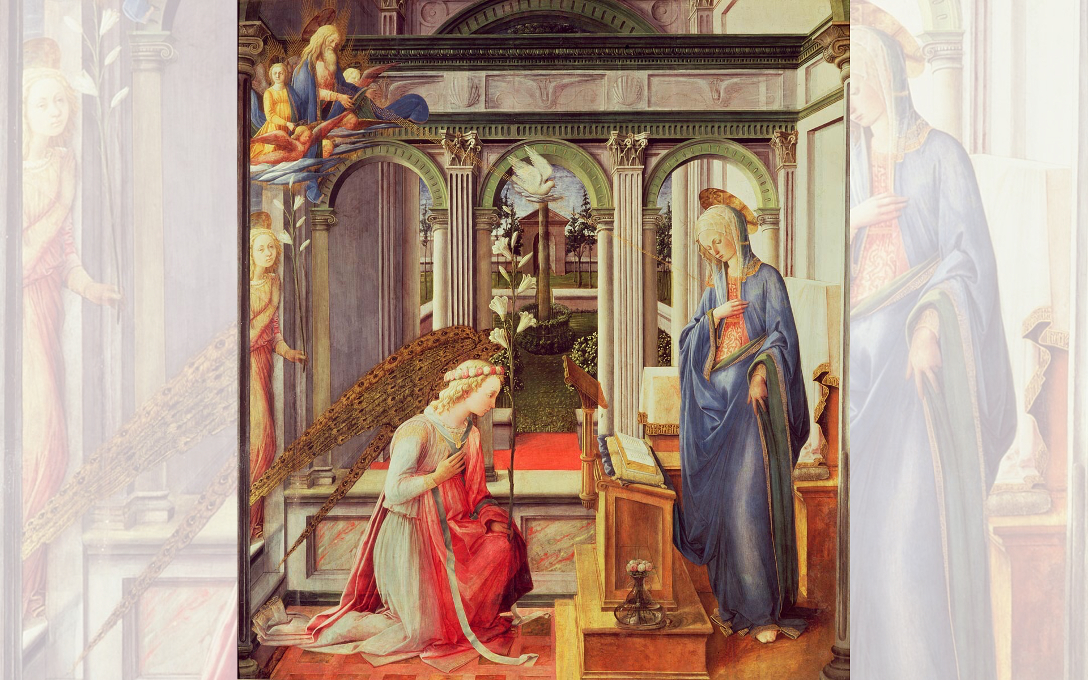
Title: Annunciation
Artist: Fra Filippo Lippi
Year: 1443

Slide 4
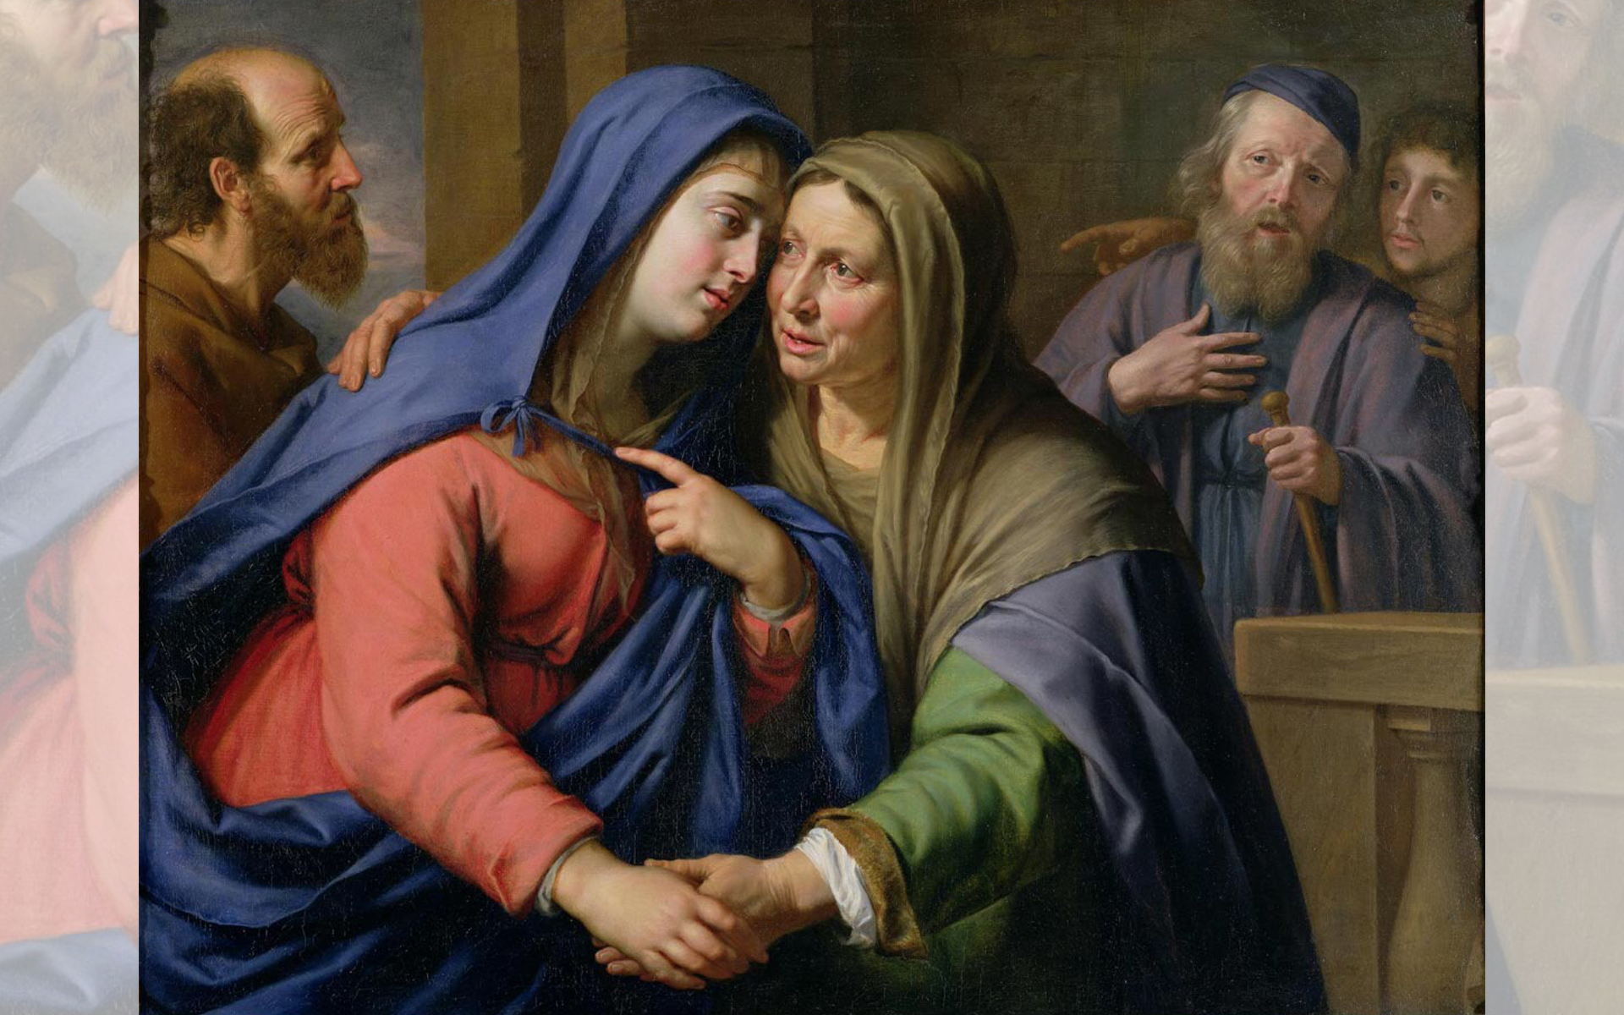
Title: The Visitation
Artist: Philippe de Champaigne
Date Unknown

Slide 5
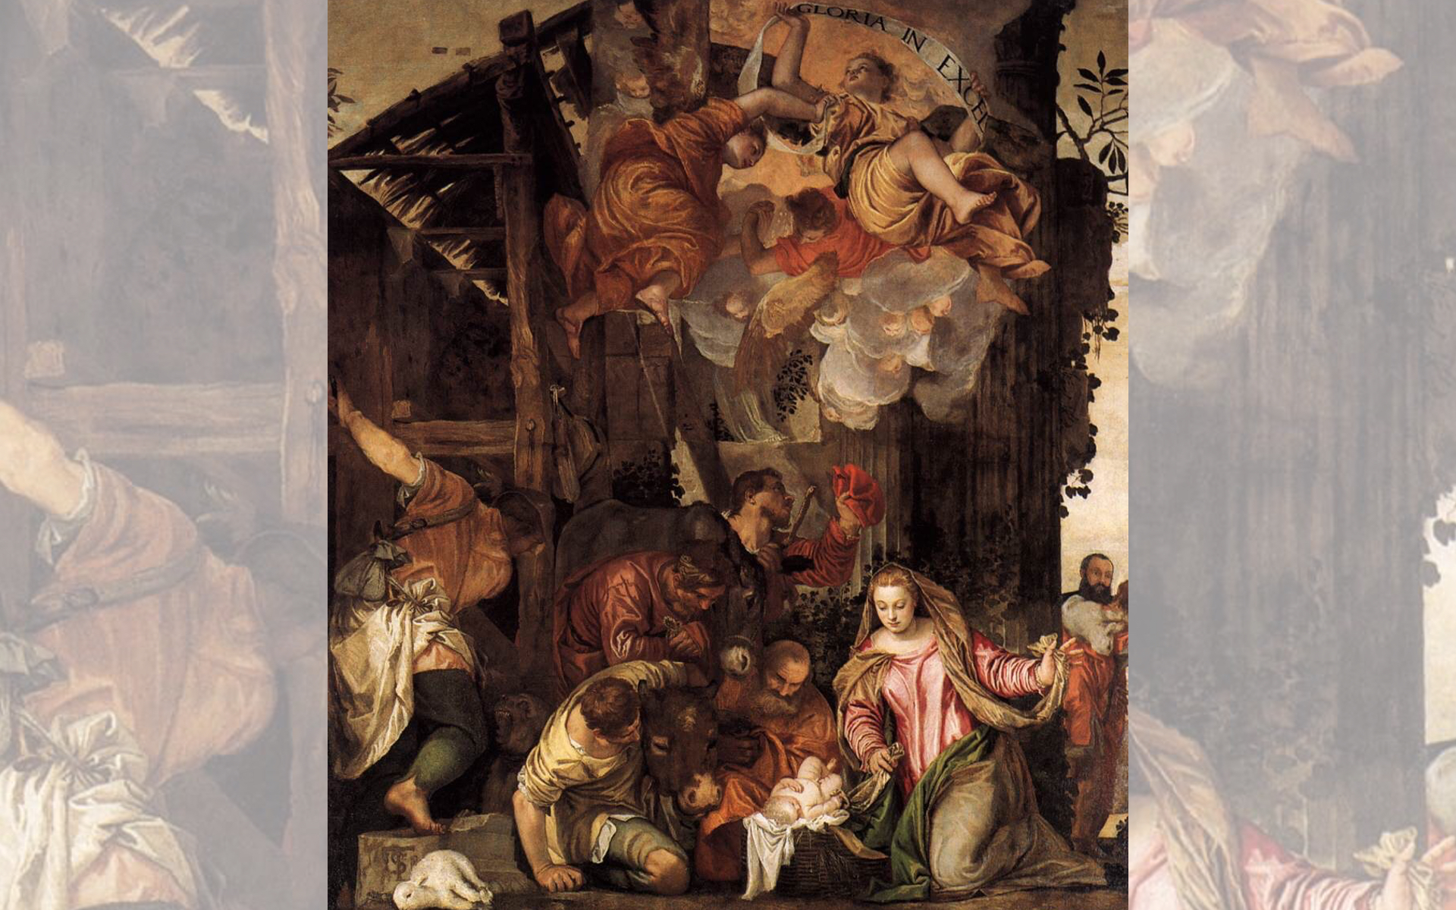
Title: Adoration of the Shepherds,
Artist: Paolo Veronese
Date Unknown

Slide 6
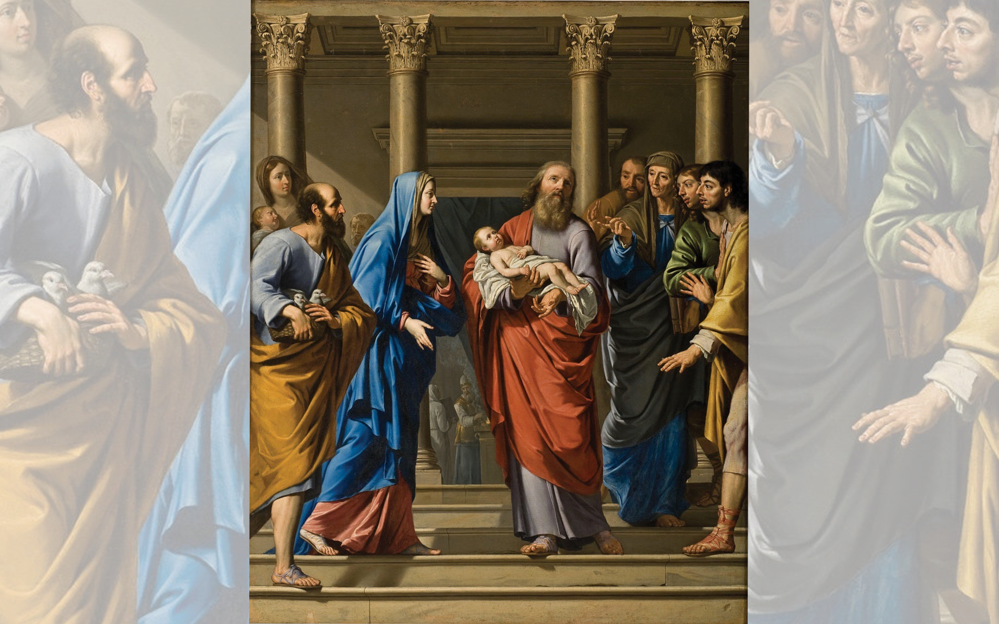
Title: The Presentation of the Temple
Artist: Philippe de Champaigne
Year: 1648

Slide 7
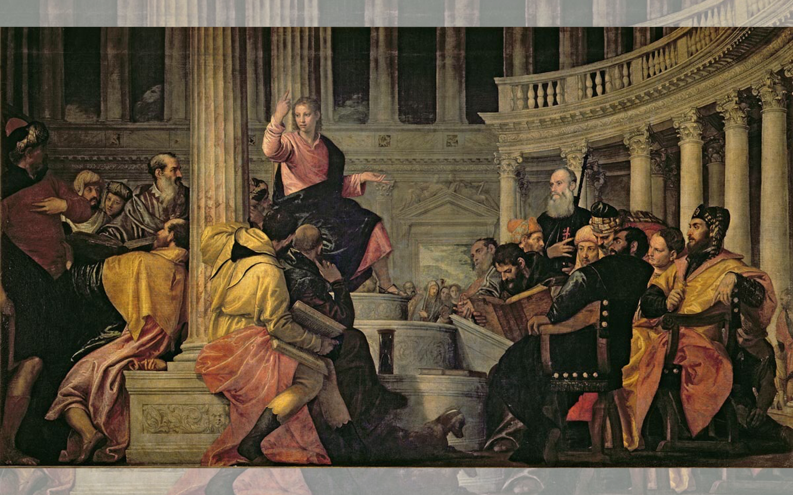
Title: Christ with the Doctors in the Temple — Artist: Paolo Veronese — Year: c. 1560

Slide 8


Slide 9
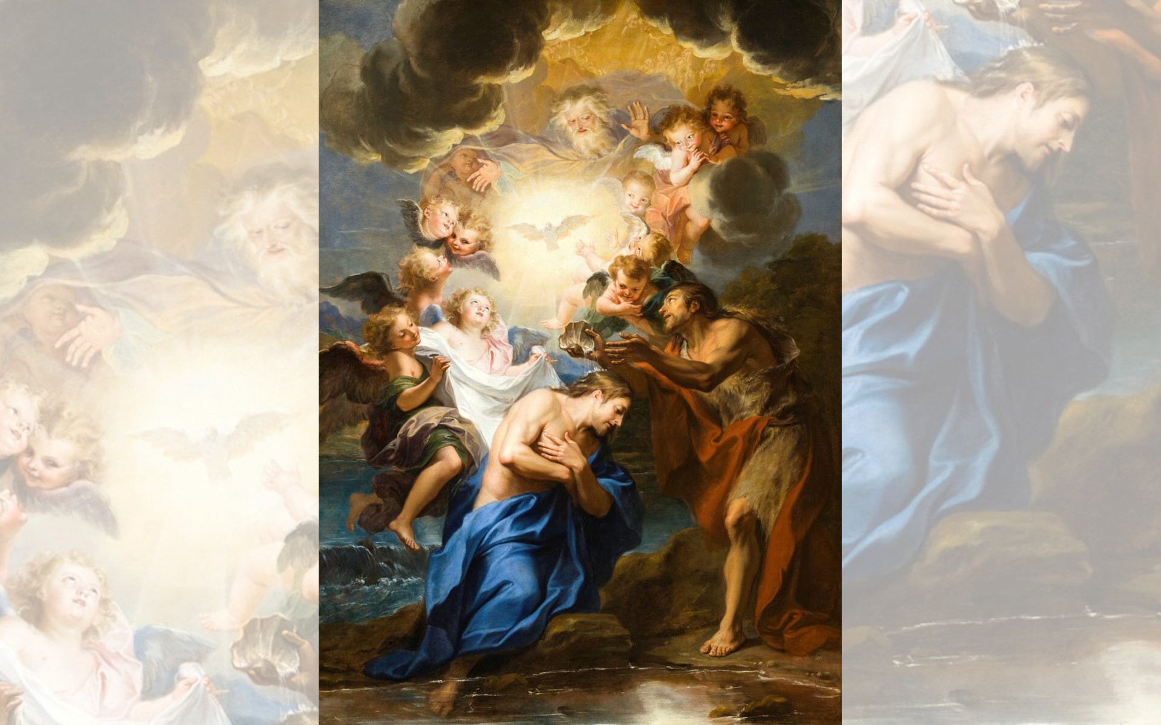
Title: The Baptism of Christ
Artist: Antoine Coypel
Year: 1690

Slide 10
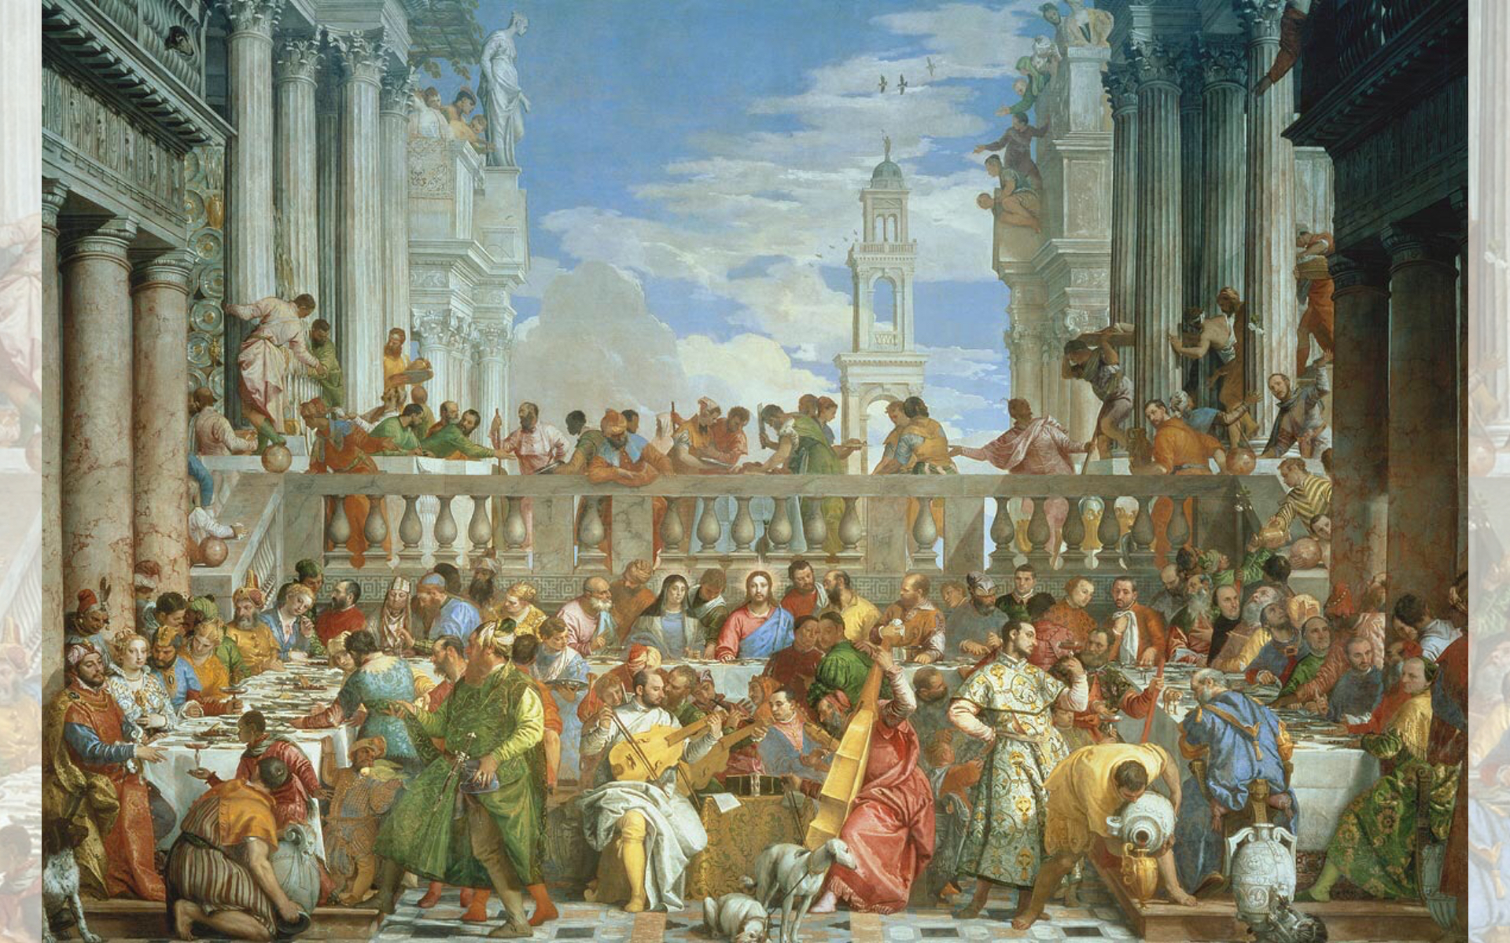
Title: The Wedding at Cana
Artist: Paolo Veronese
Year: 1563

Slide 11
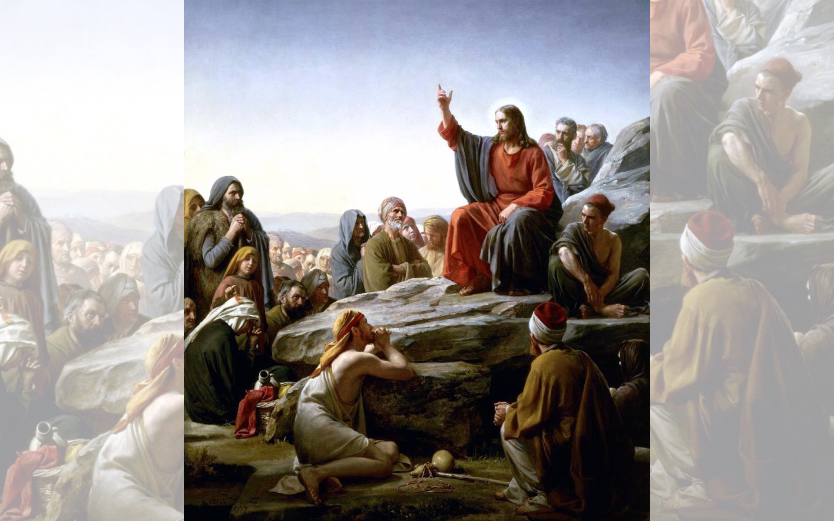
Title: The Sermon on the Mount
Artist: Carl Heinrich Bloch
Date Unknown

Slide 12
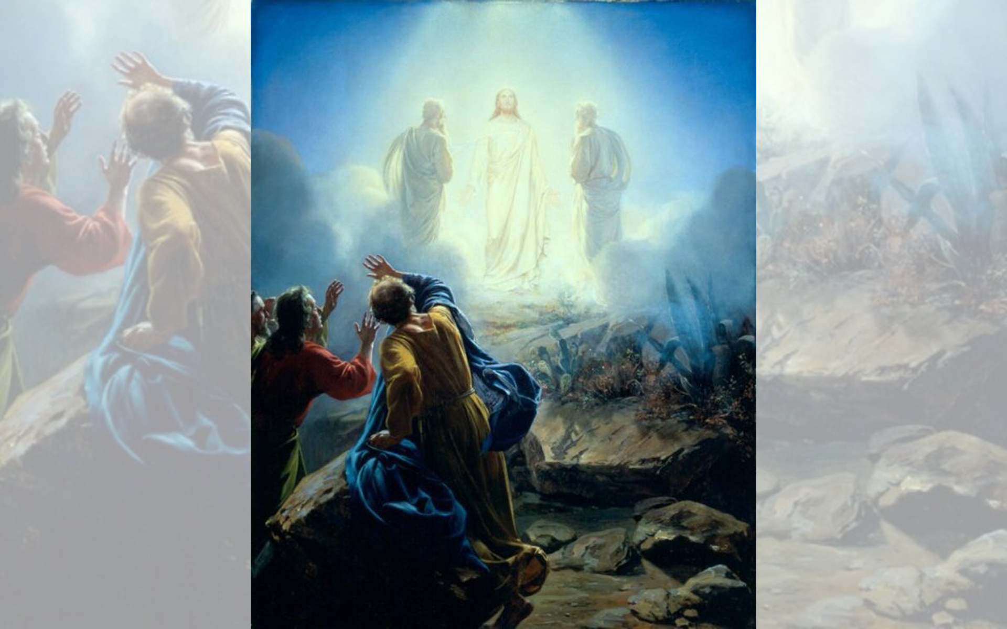
Title: The Transfiguration
Artist: Carl Heinrich Bloch
Date Unknown

Slide 13
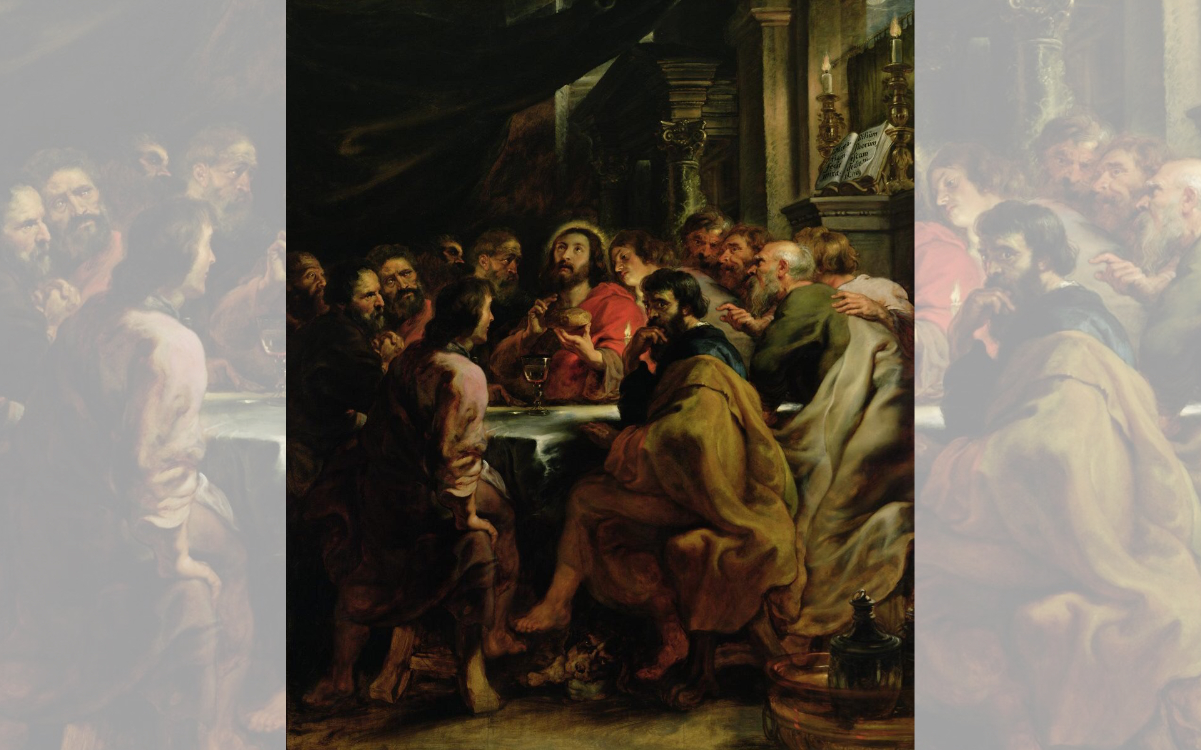
Title: Last Supper
Artist: Peter Paul Rubens
Year: 1631-1632

Slide 14


Slide 15
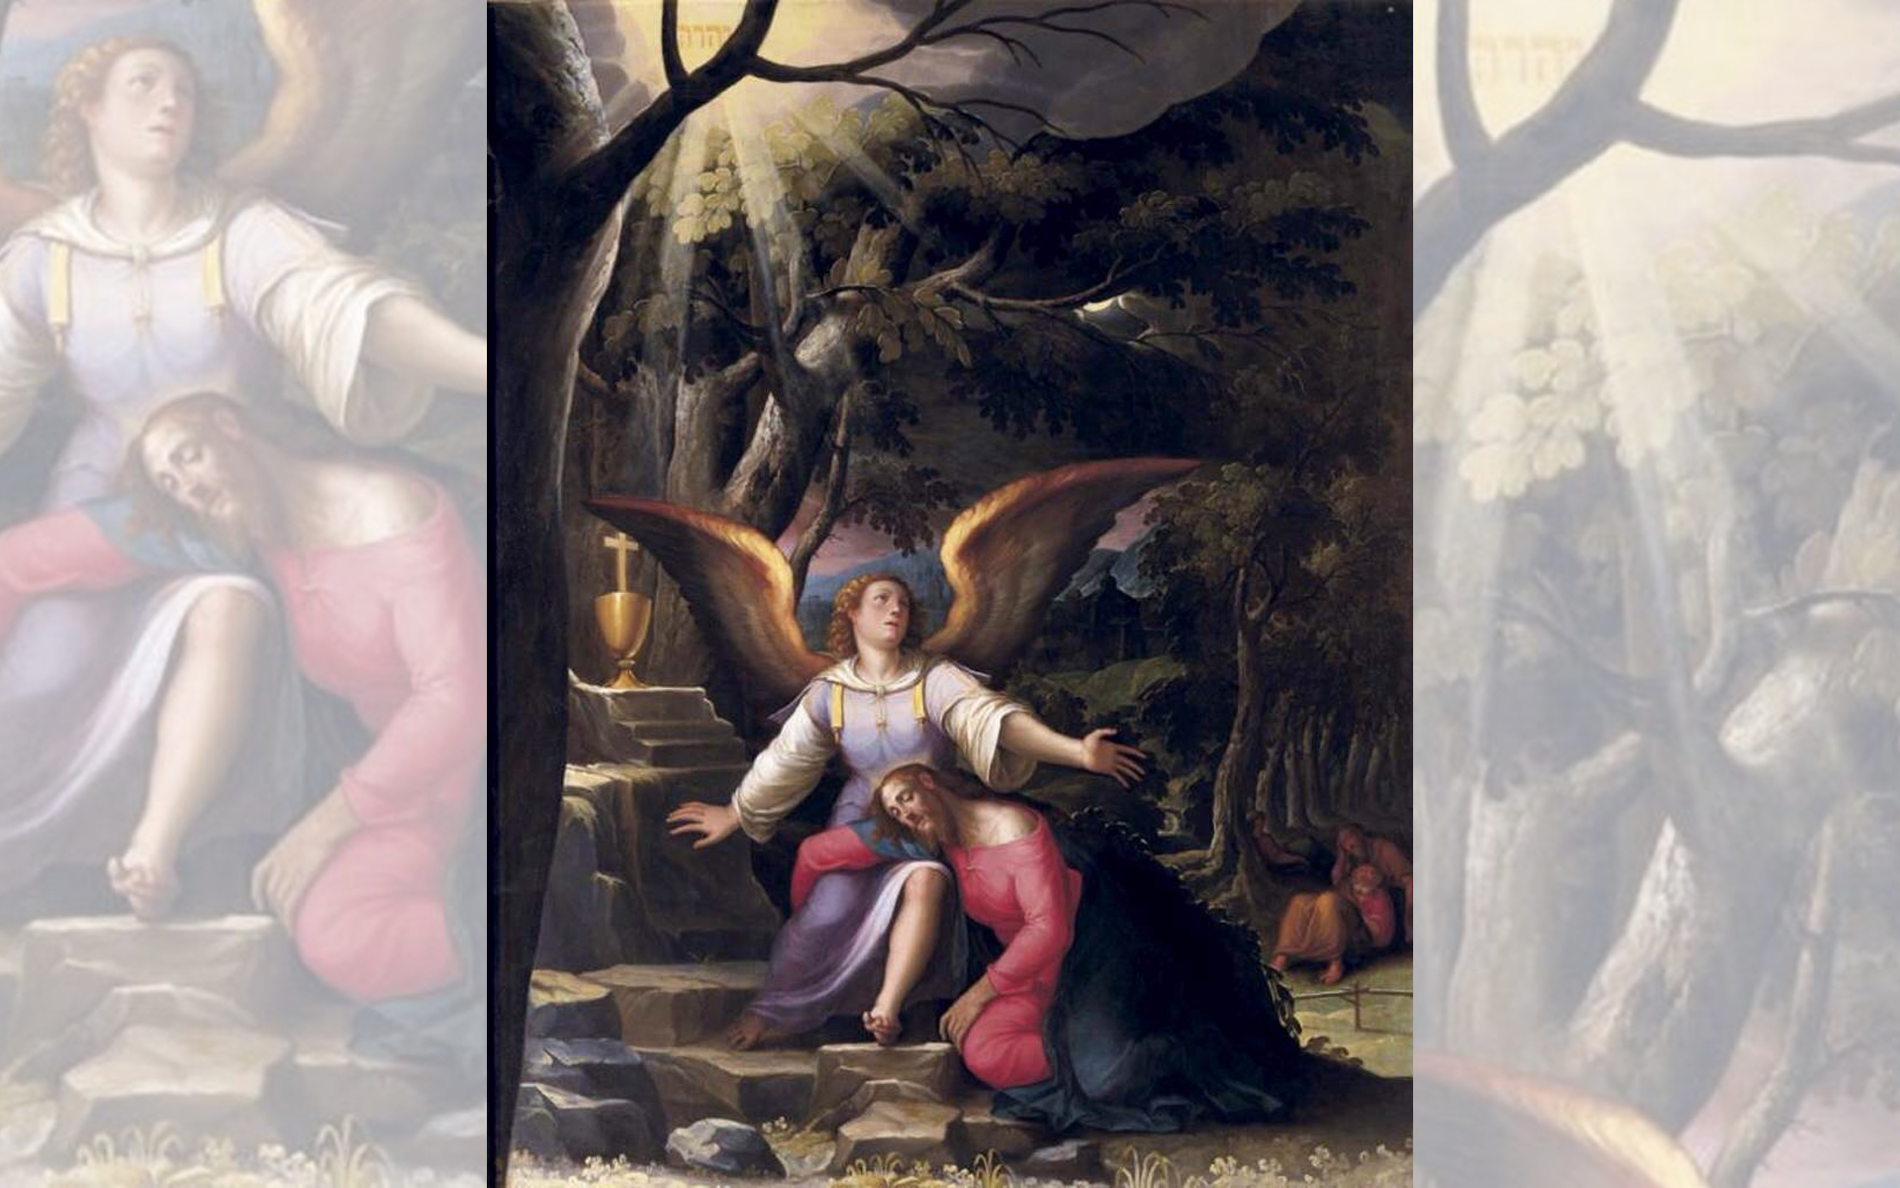
Title: Agony in the Garden
Artist: Jacopo Ligozzi
Year: c.1587

Slide 16
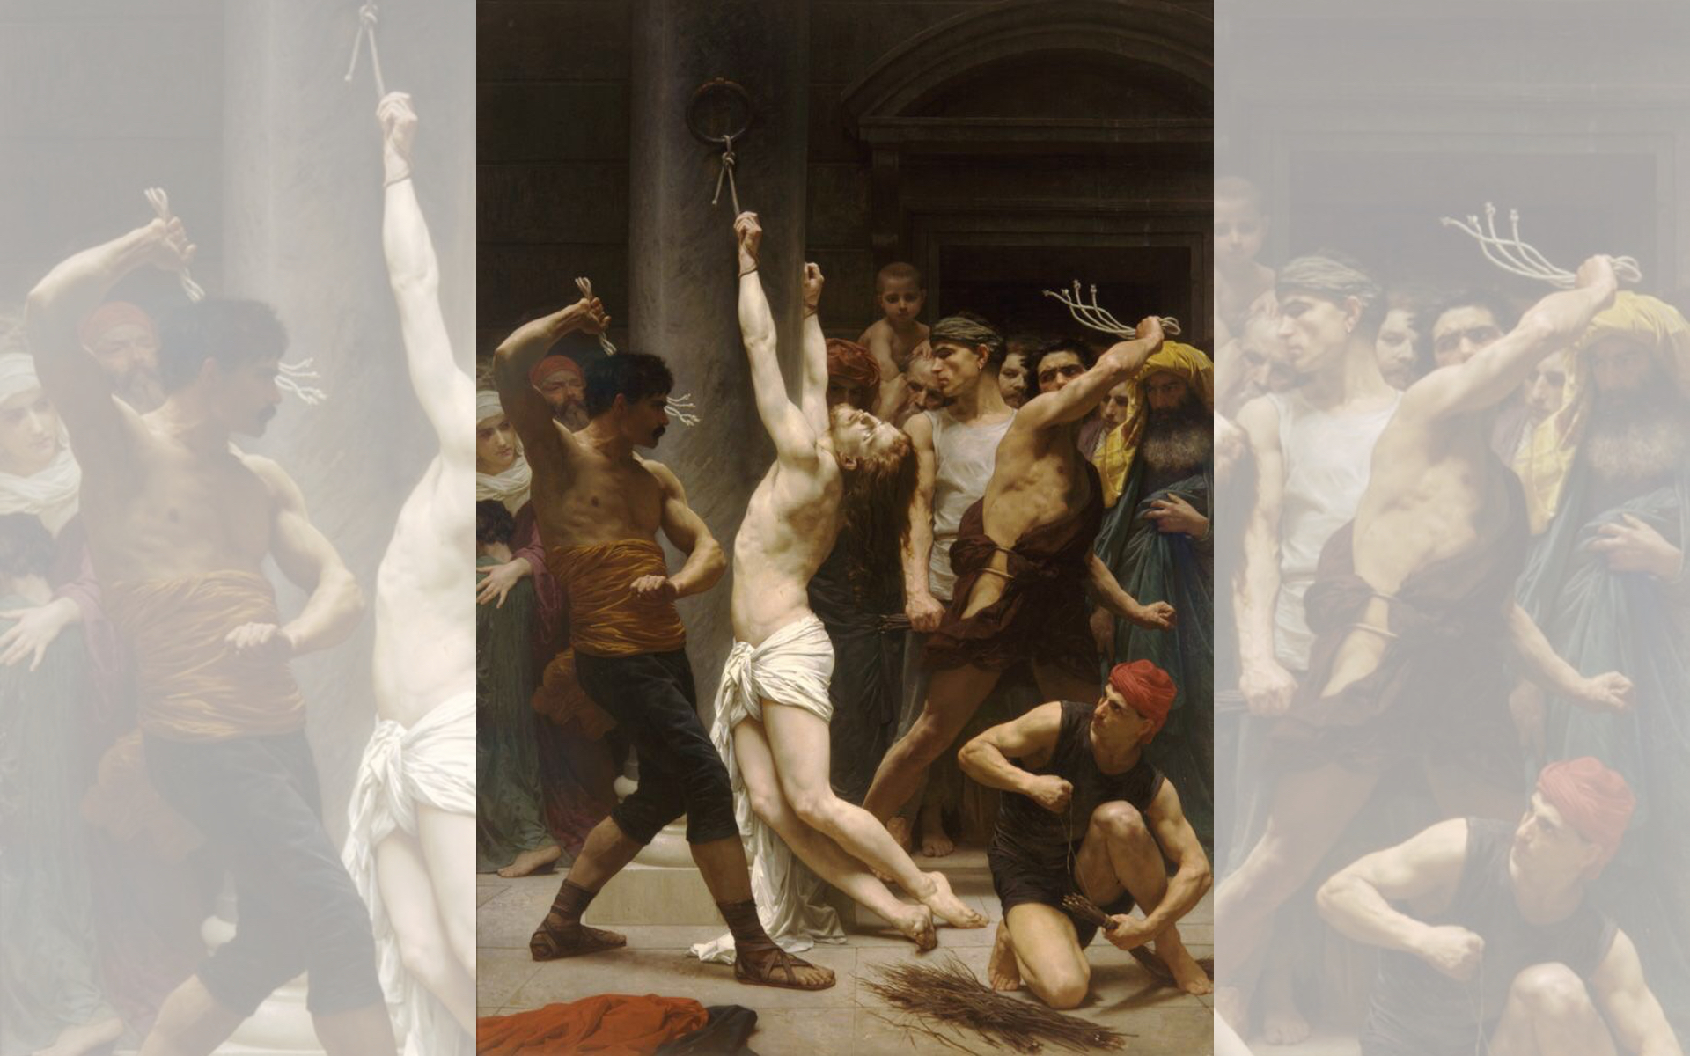
Title: The Flagellation of Our Lord Jesus Christ
Artist: William-Adolphe Bouguereau
Year: 1880

Slide 17
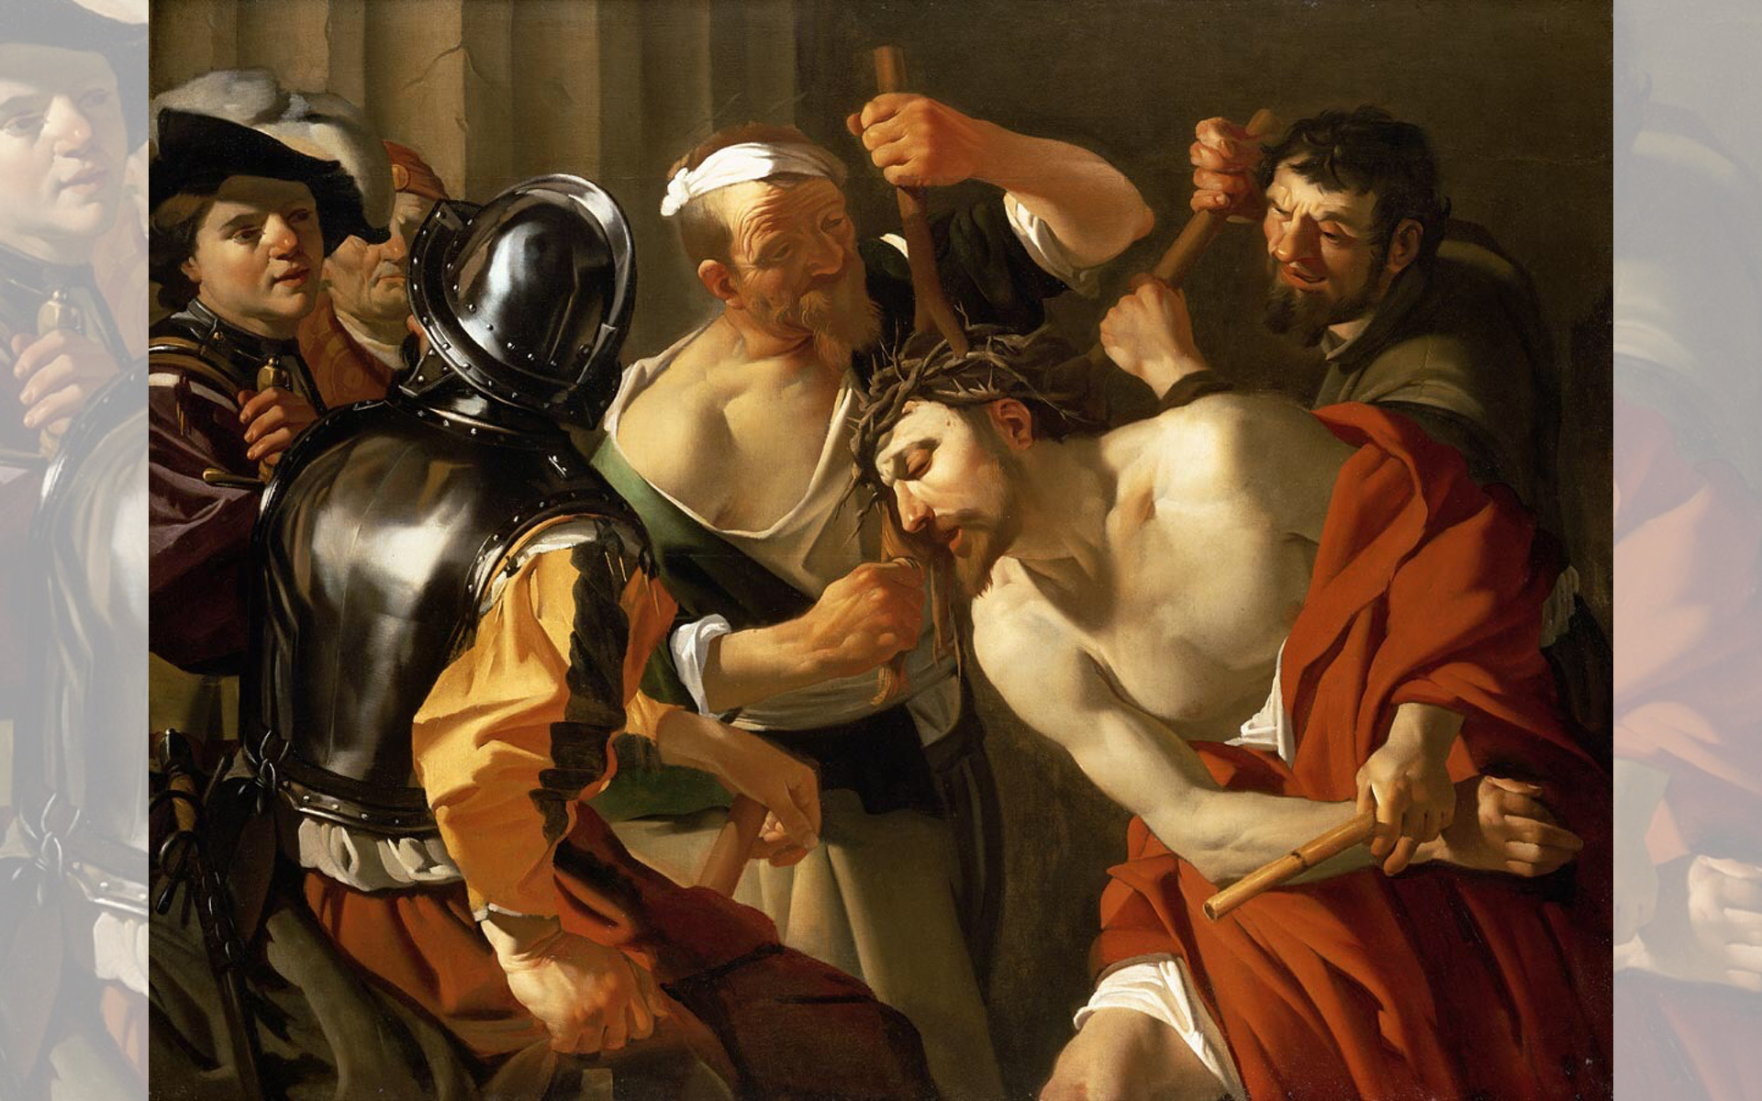
Title: Crowning with Thorns — Artist: Dirck van Baburen — Year: c. 1622

Slide 18
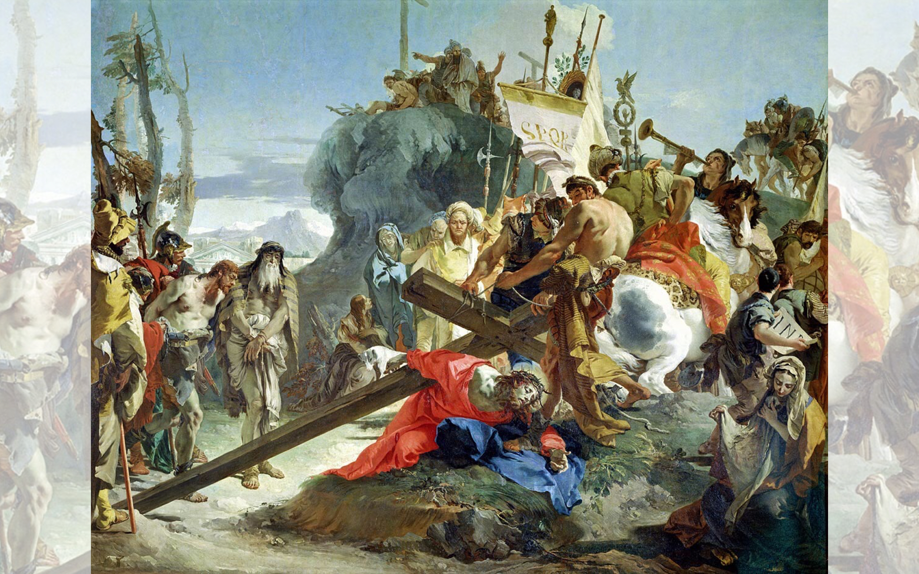
Title: Christ Carrying the Cross
Artist: Giovanni Battista Tiepolo
Year: 1737-1738

Slide 19
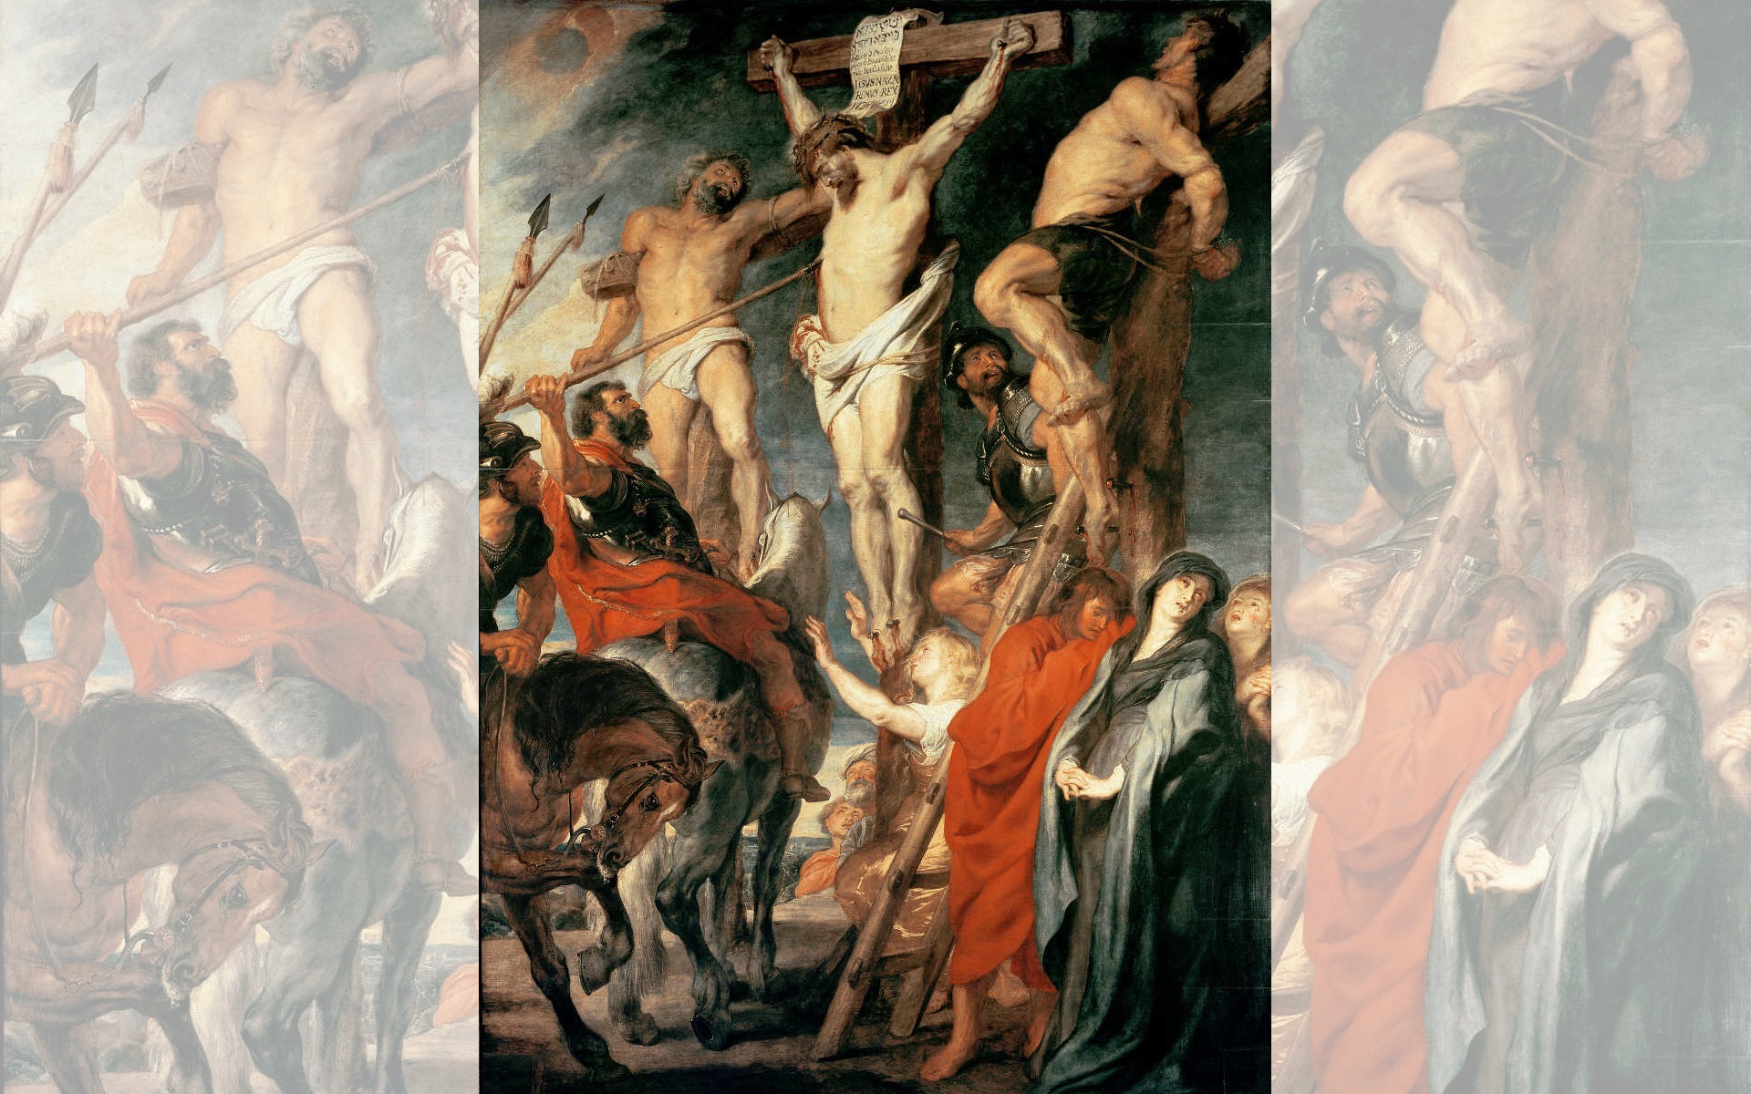
Title: Christ on the Cross between Two Thieves
Artist: Peter Paul Rubens
Year: 1619-1620

Slide 20


Slide 21
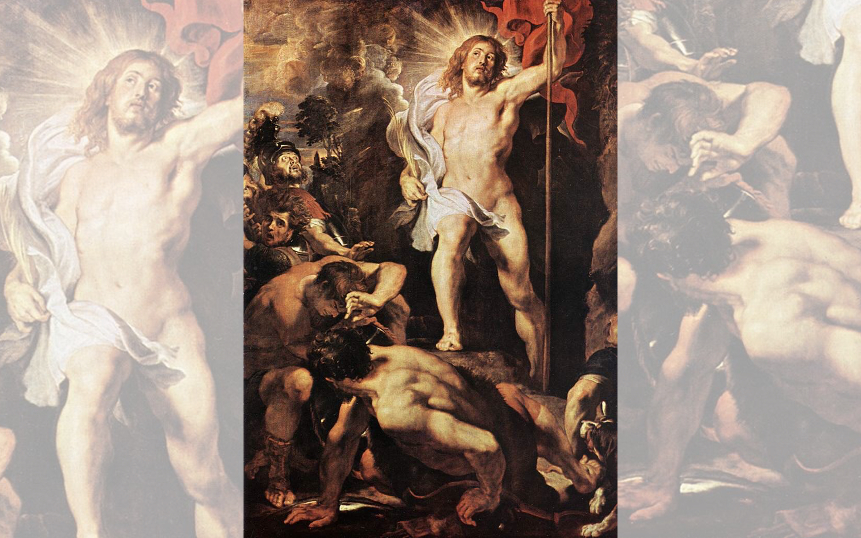
Title: The Resurrection of Christ
Artist: Peter Paul Rubens
Year: 1611-1612

Slide 22
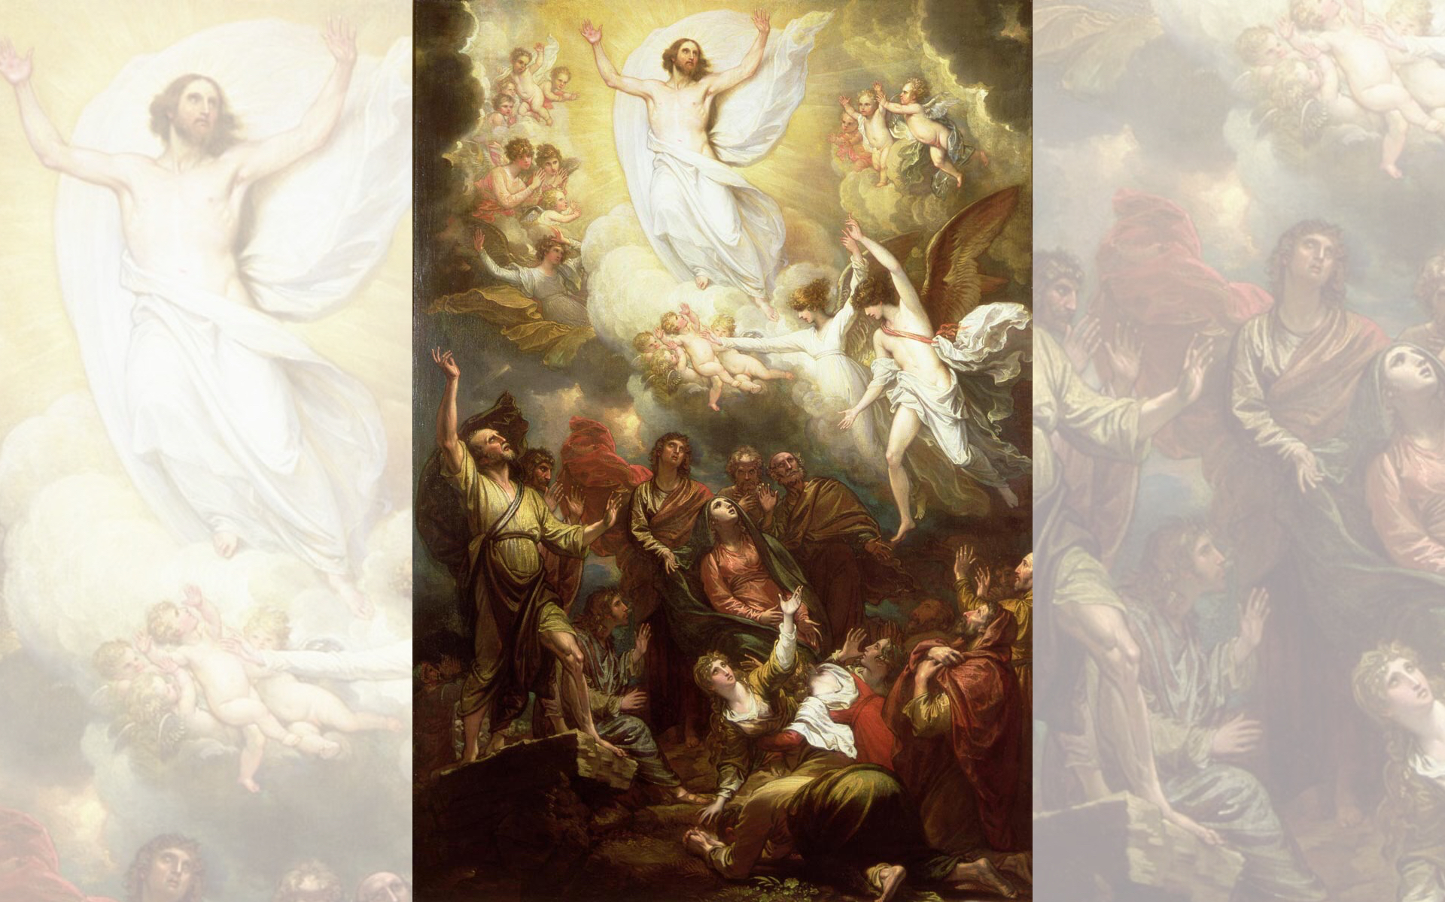
Title: The Ascension,
Artist: Benjamin West
Year: Date Unknown

Slide 23
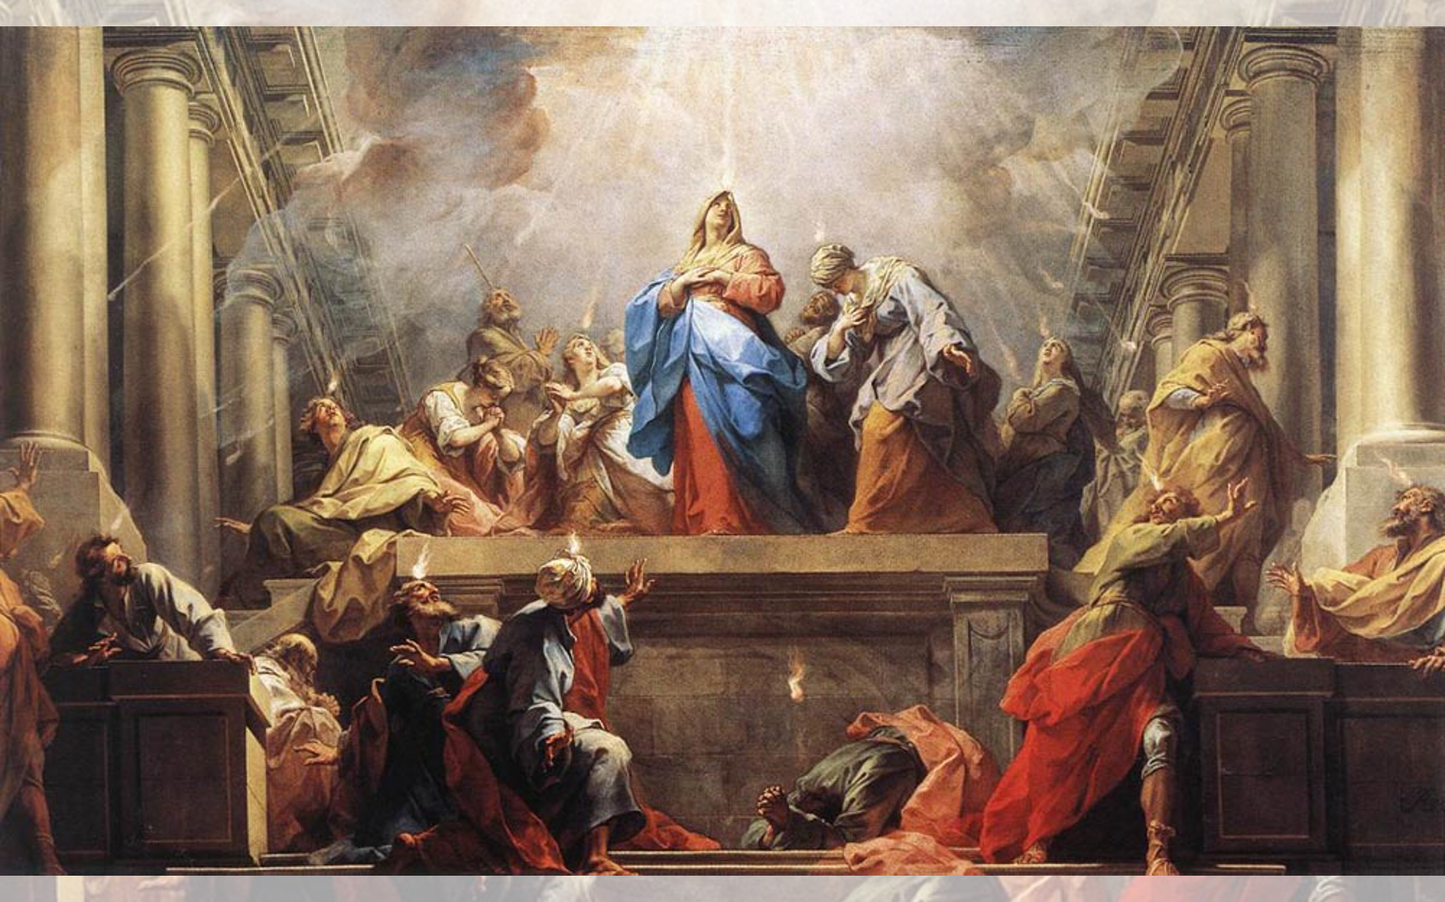
Title: Pentecost — Artist: Jean II Restout — Year: 1732

Slide 24
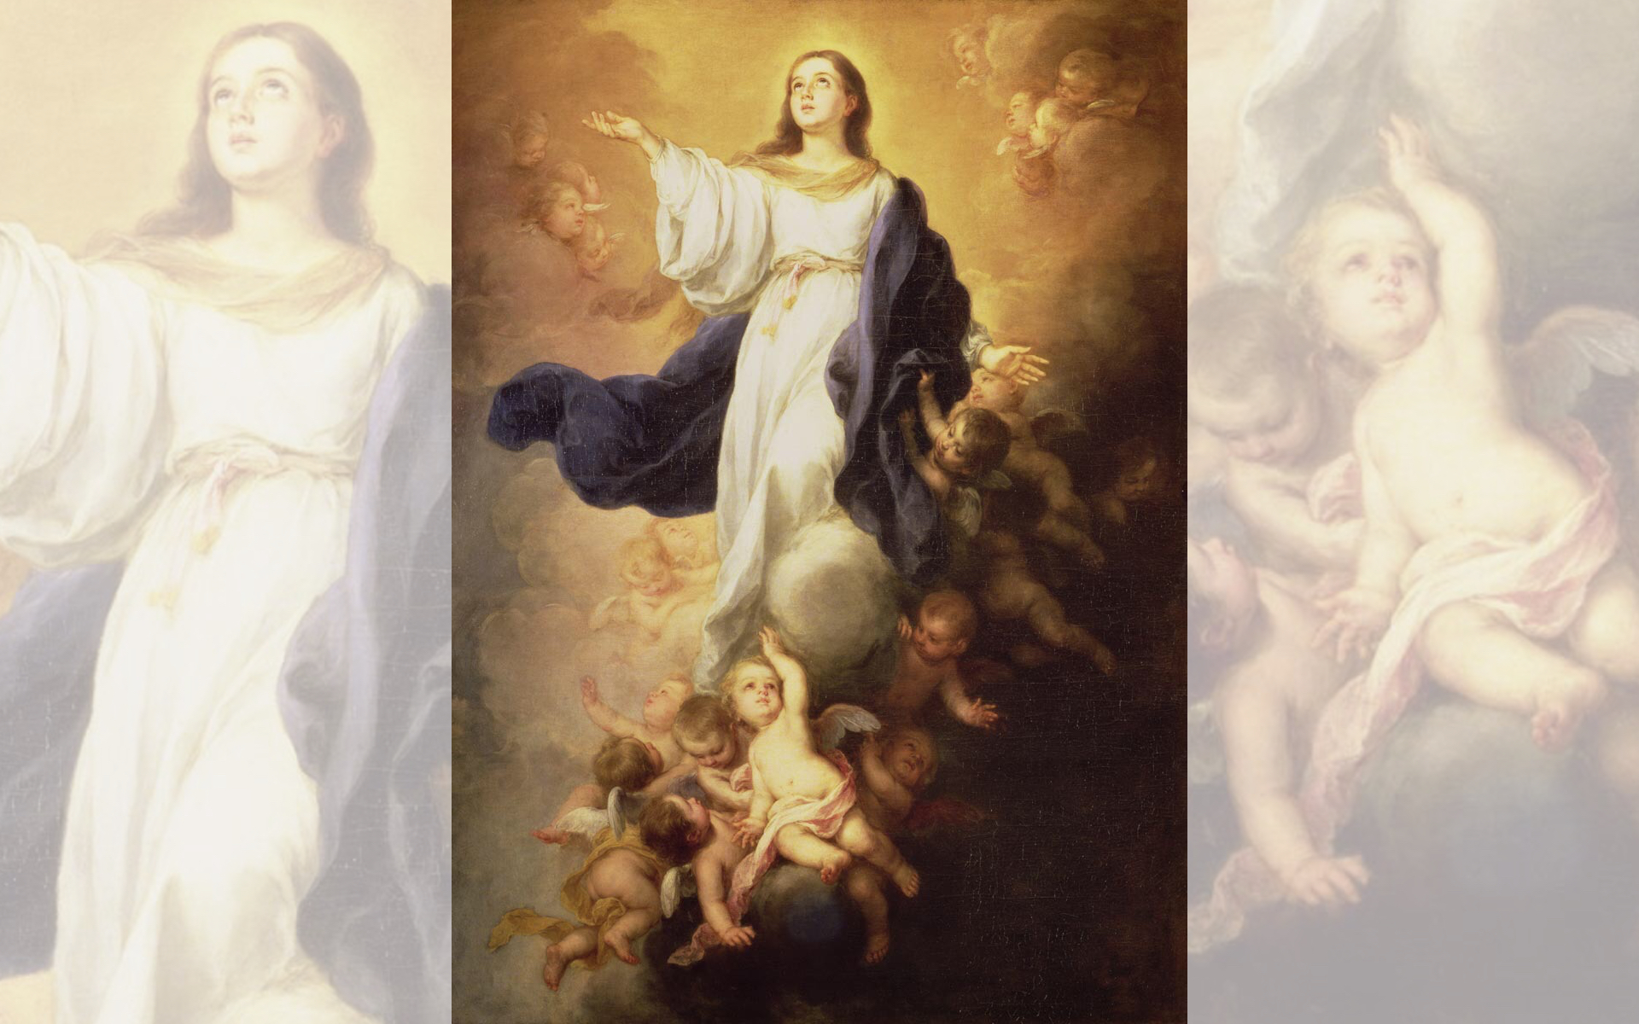
Title: The Assumption of the Virgin
Artist: Bartolomé Esteban Murillo
Year: 1670s

Slide 25
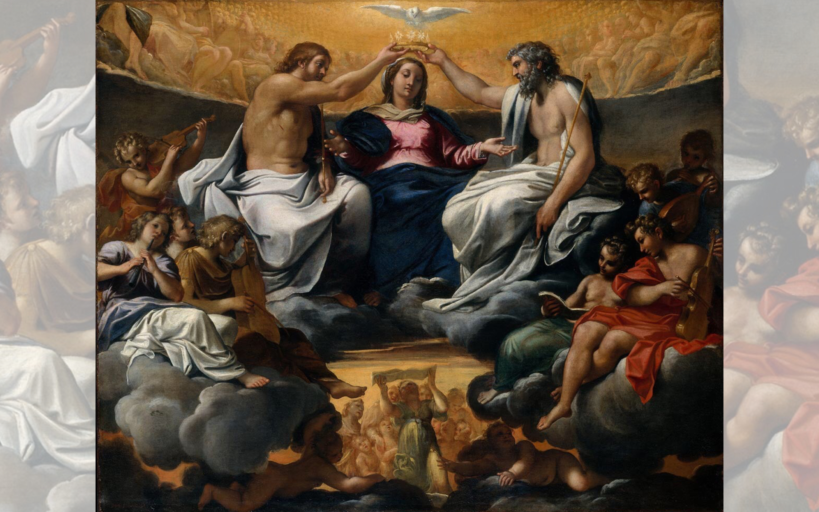
Title: The Coronation of the Virgin
Artist: Annibale Carracci
Year: After 1595

Slide 26
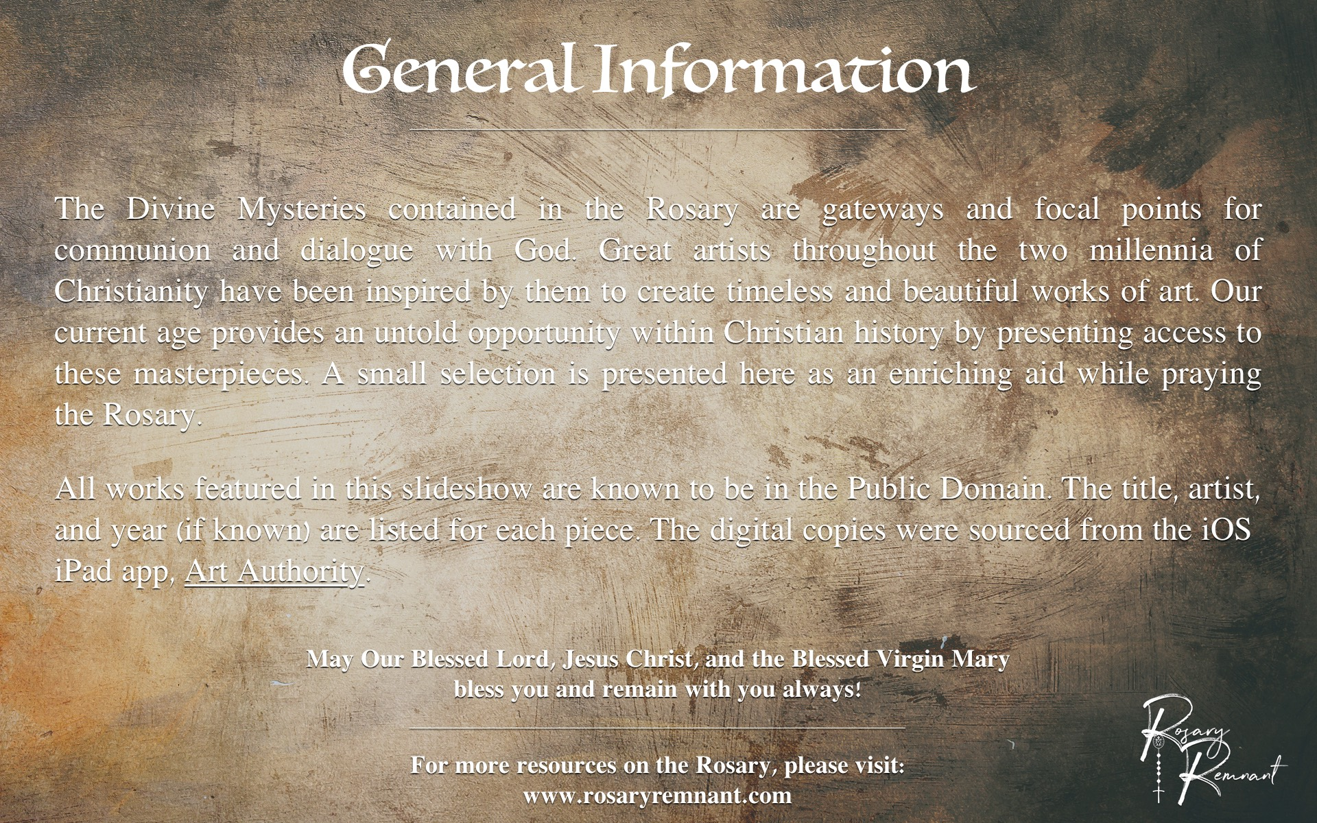

Slide 27
